Slide 1
Instrumental Variables Beating endogeneity…with music? by Ralf Martin (r.martin@imperial.ac.uk)

Slide 2
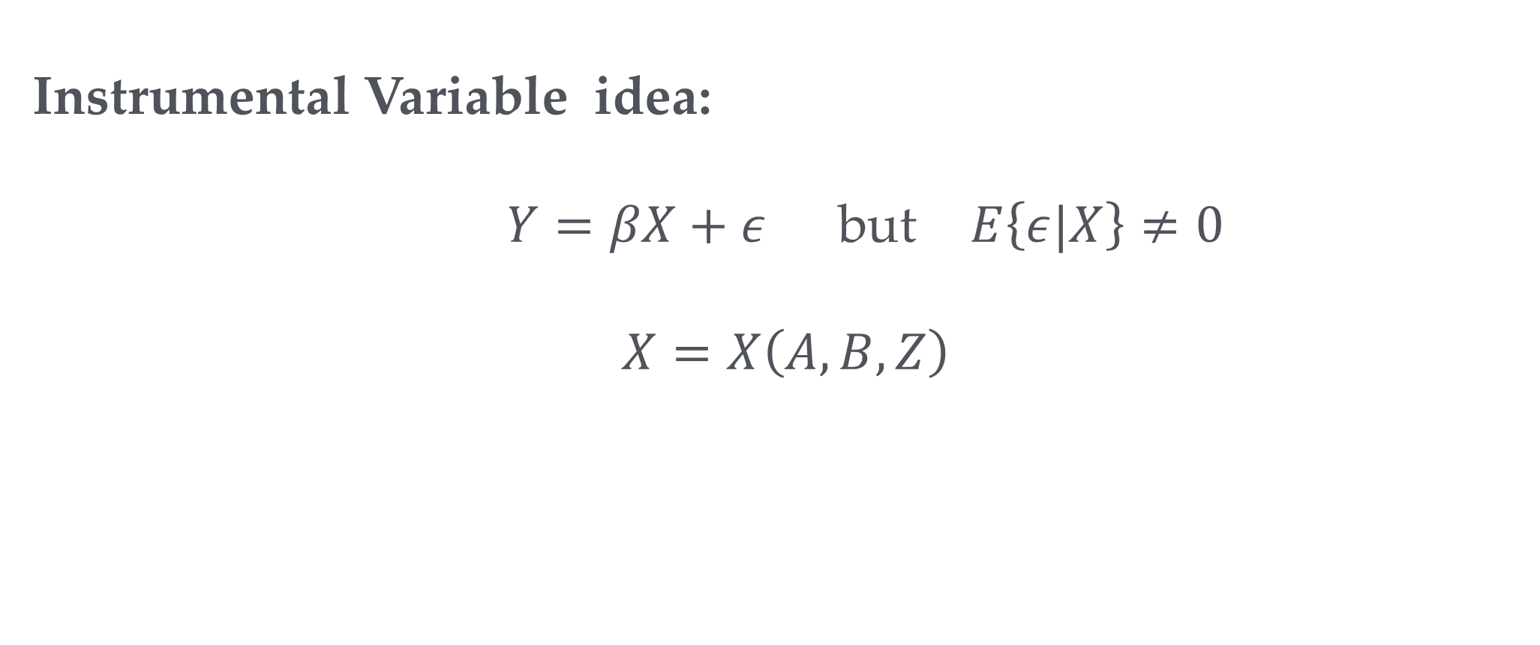
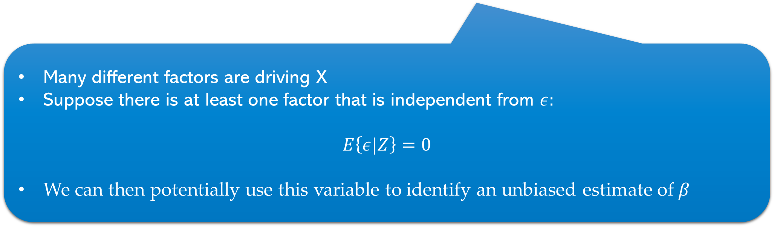
Fixing endogeneity
Endogeneity Problem
Instrumental Variable idea:
$Y=βX+ε$but $E\left\{ε|X\right\}≠0$
$$X=X\left(A, B, Z\right)$$
Many different factors are driving X
Suppose there is at least one factor that is independent from $ε:$
$$E\left\{ε|Z\right\}=0$$
We can then potentially use this variable to identify an unbiased estimate of $β$

Slide 3
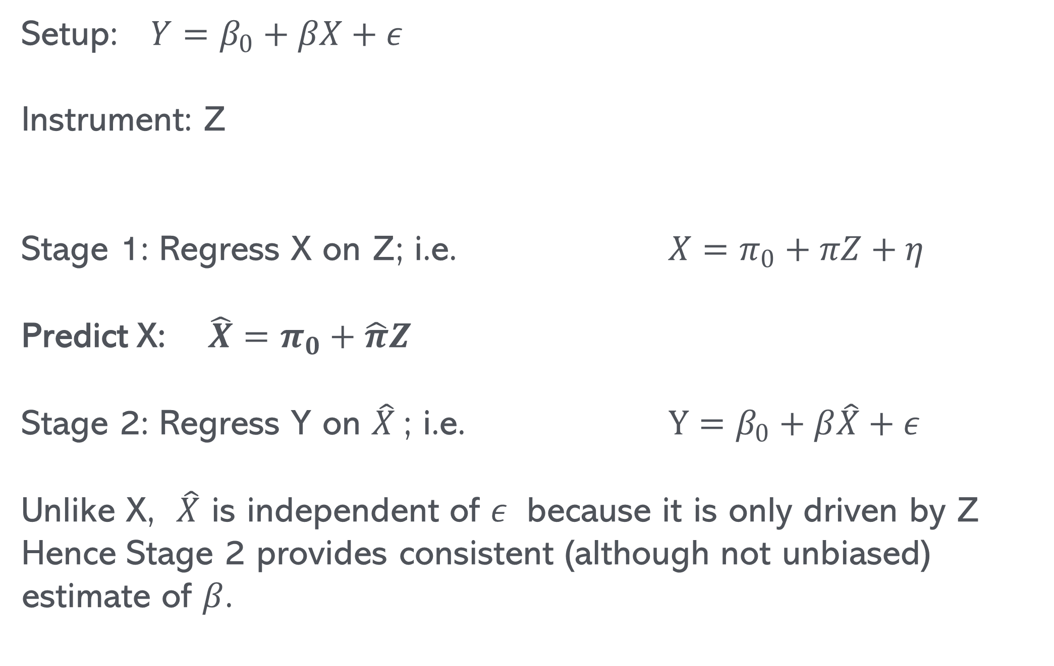
2 Stage Least Squares Estimator (2 SLS)
Setup: $Y=β_{0}+βX+ε$
Instrument: Z
Stage 1: Regress X on Z; i.e. $X=π_{0}+πZ+η$
Predict X: $\hat{X}=π_{0}+\hat{π}Z$
Stage 2: Regress Y on $\hat{X}$; i.e. $Y=β_{0}+β\hat{X}+ε$
Unlike X, $\hat{X}$ is independent of $ε$ because it is only driven by Z
Hence Stage 2 provides consistent (although not unbiased) estimate of $β$.

Slide 4
3 Requirements for instrumental variables
→
Must be argued
Can be checked
Must be independent of shocks
Must be driver of variable of interest
Must not affect outcome variable other than trough variable of interest (Exclusion restriction, kind of implied by 1)
IV easily generalizes to non dummy variables
Can also combine with having many additional control variables
The tool to we use is called 2 stage least squares (2SLS)
Suppose we send all losers a letter saying that they are incompetent and useless

Slide 5


A graphical representation of IV
$$Y=Xβ+ϵ$$
Criterion 3
Criterion 2
Criterion 1
$$Z$$

Slide 6
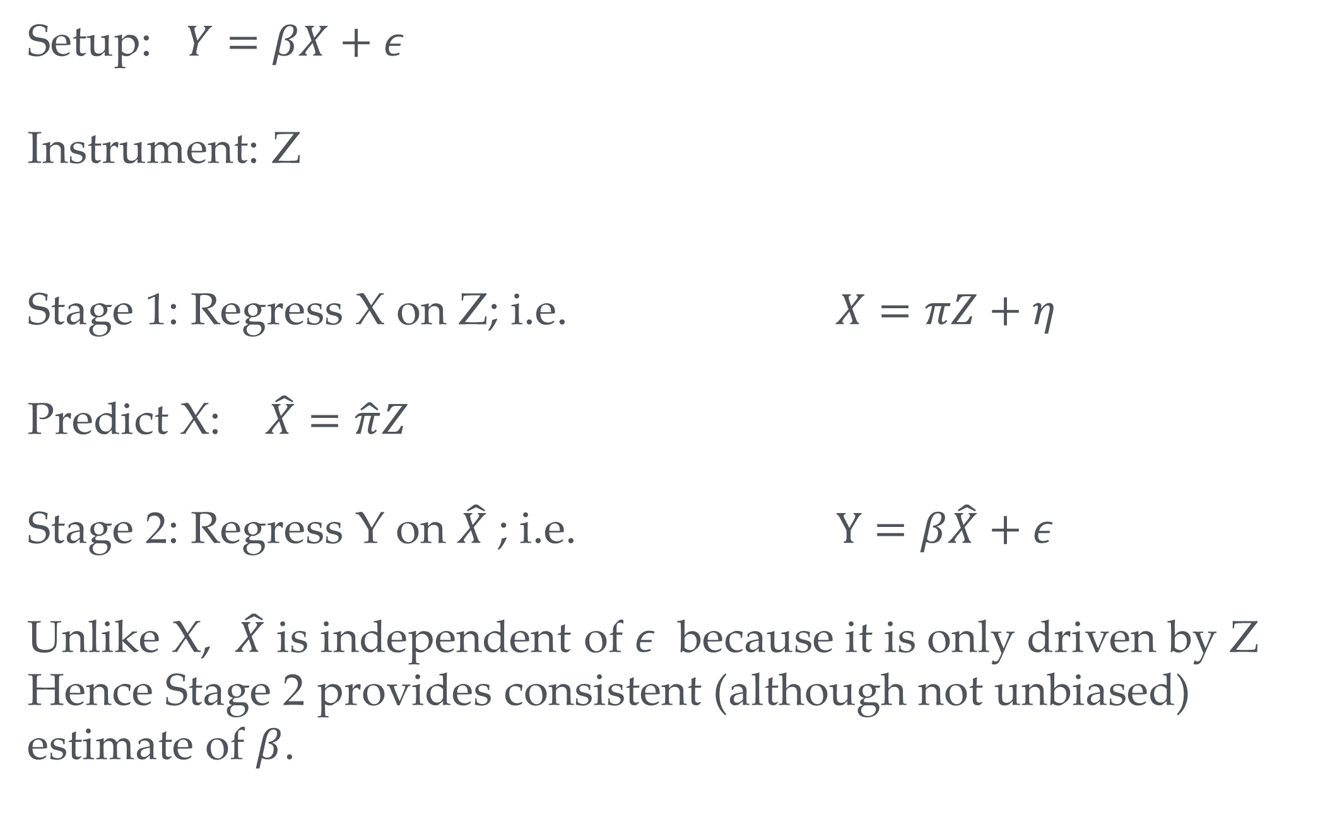
2 stage least squares (2SLS)
→
Setup: $Y=βX+ε$
Instrument: Z
Stage 1: Regress X on Z; i.e. $X=πZ+η$
Predict X: $\hat{X}=\hat{π}Z$
Stage 2: Regress Y on $\hat{X}$; i.e. $Y=β\hat{X}+ε$
Unlike X, $\hat{X}$ is independent of $ε$ because it is only driven by Z
Hence Stage 2 provides consistent (although not unbiased) estimate of $β$.

Slide 7
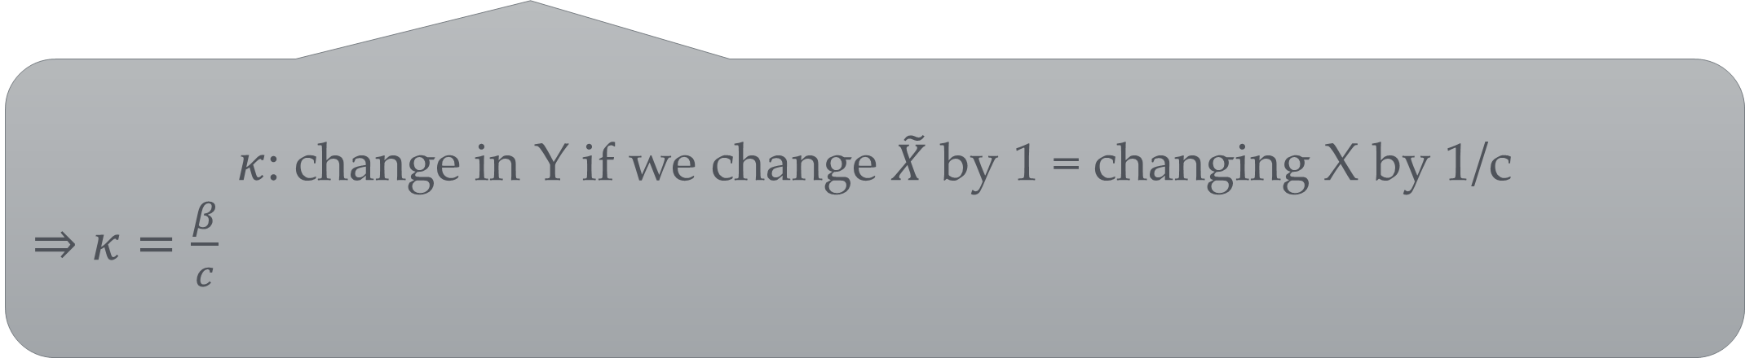
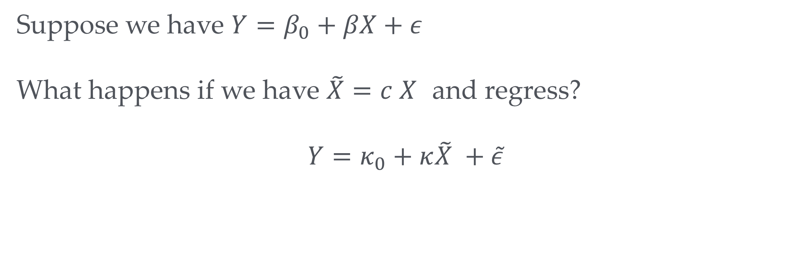
2SLS vs KIPP
Suppose we have $Y=β_{0}+βX+ε$
What happens if we have $\tilde{X}=c X$ and regress?
$$Y=κ_{0}+κ\tilde{X} +\tilde{ε}$$
$κ$: change in Y if we change $\tilde{X}$ by 1 = changing X by 1/c
⇒ $κ=\frac{β}{c}$

Slide 8
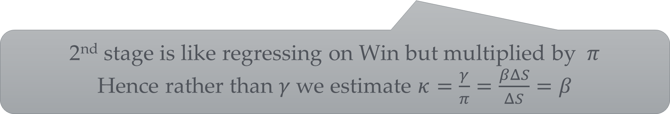
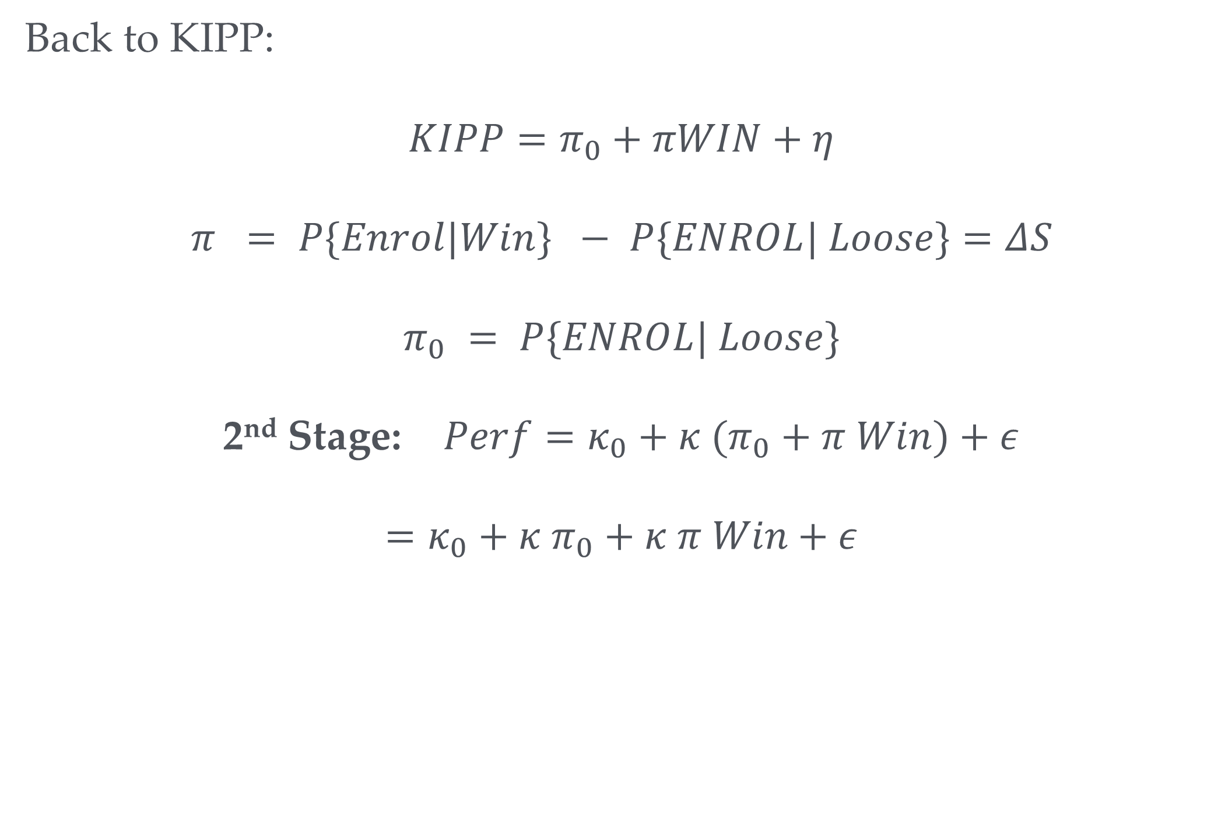
2SLS vs KIPP
Back to KIPP:
$$KIPP=π_{0}+πWIN+η$$
$$π = P\{Enrol|Win\} − P\{ENROL| Loose\}=ΔS$$
$$π_{0} = P\{ENROL| Loose\}$$
2nd Stage: $Perf=κ_{0}+κ (π_{0}+π Win)+ε$
$$=κ_{0}+κ π_{0}+κ π Win+ε$$
2nd stage is like regressing on Win but multiplied by $π$
Hence rather than $γ$we estimate $κ=\frac{γ}{π}=\frac{βΔS}{ΔS}=β$

Slide 9
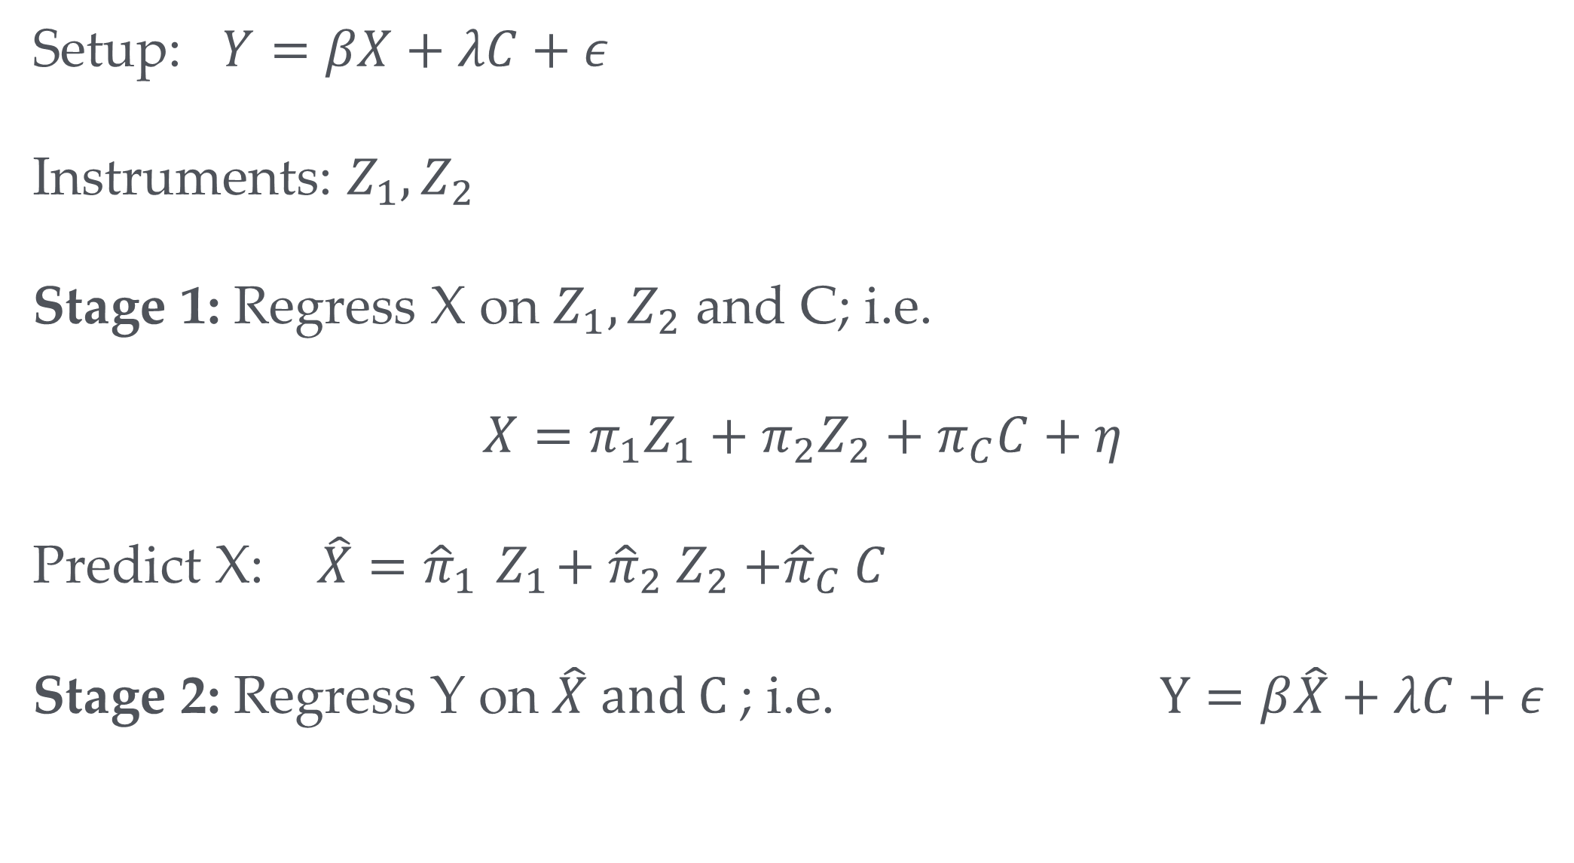
IV with many control variables and instruments
Setup: $Y=βX+λC+ε$
Instruments: $Z_{1},Z_{2}$
Stage 1: Regress X on $Z_{1},Z_{2}$ and C; i.e.
$$X=π_{1}Z_{1}+π_{2}Z_{2}+π_{C}C+η$$
Predict X: $\hat{X}={\hat{π}}_{1}{ Z}_{1}+{\hat{π}}_{2} Z_{2}{+\hat{π}}_{C}C$
Stage 2: Regress Y on $\hat{X} and C$; i.e. $Y=β\hat{X}+λC+ε$
Note: 2SLS is only consistent but not unbiased

Slide 10
Implementation in R
ivreg(y ~ x + control | IV + control, data=<dataset>)
Before we look more closely at how to implement the IV estimator let’s develop another example

Slide 11
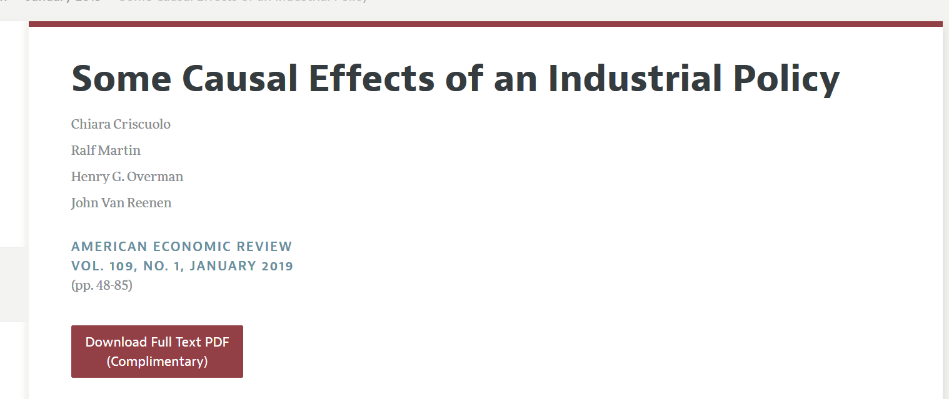

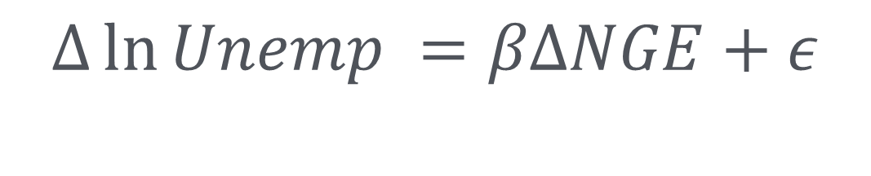
Another example:
Subsidies and Unemployment
$$Δ\ln{Unemp} =βΔNGE+ε$$
Change in (log) unemployment between 2002 and 1997
Change in support rate

Slide 12

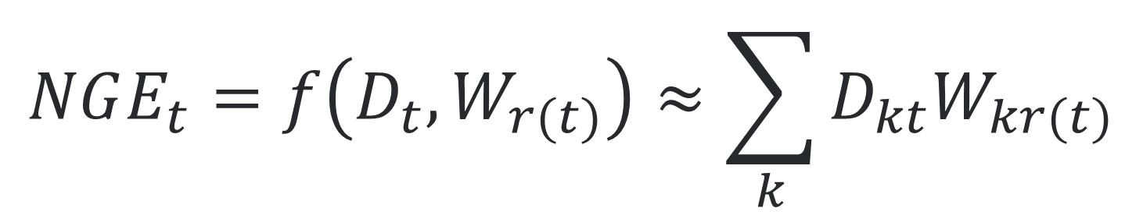
Instrument construction
Know your history
How much support an area gets is based on how
Various indicators of past deprivation (GDP, unemployment, etc.)
Weightings for different indicators
In reality not linear but let’s use as approximation
$$NGE_{t}=f\left(D_{t},W_{r(t)}\right)≈\sum_{k}{D_{kt}W_{kr(t)}}$$
Indicators of Deprivation
Rules that apply in period t. Change every 7 years; e.g. in 2000
Weights of different indicators (Determined by EU rules)

Slide 13

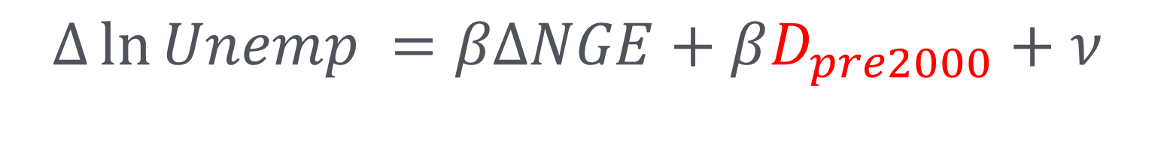

Instrument construction
$$Δ\ln{Unemp} =βΔNGE+βD_{pre2000}+ν$$
$ΔNGE=\sum_{k}{D_{k,2002}W_{k,post2000}}$-$D_{k,1997}W_{k,pre2000}$
$ΔZ=\sum_{k}{D_{k,pre2000}W_{k,post2000}}$-$D_{k,pre2000}W_{k,pre2000}$
After controlling for $D_{k,pre2000}$, $ΔZ$ does no longer depend on $ν$ and thus becomes valid instrument

Slide 14
Implementation
df=read_dta( "../data/unempprep.dta")
# Simple OLS regOLS=lm( DDDln1Punemp ~ DDDNGE ,df) summary(regOLS)
## ## Call: ## lm(formula = DDDln1Punemp ~ DDDNGE, data = df) ## ## Residuals: ## Min 1Q Median 3Q Max ## -3.5451 -0.1907 0.0165 0.2109 2.8601 ## ## Coefficients: ## Estimate Std. Error t value Pr(>|t|) ## (Intercept) -0.462220 0.003648 -126.703 < 2e-16 *** ## DDDNGE -0.221062 0.036012 -6.138 8.62e-10 ***
A change in support from 0 to 10% (0-0.1) will reduce unemployment by 2.2%

Slide 15

IV
$$ΔZ$$
A change in support from 0 to 10% (0-0.1) will reduce unemployment by 4.5%

Slide 16
First Stage

Slide 17
F-test of Z=0
F statistic is larger 10…hurray!!!

Slide 18
Reduced Form
IF reduced form is not significant IV will not be either

Slide 19
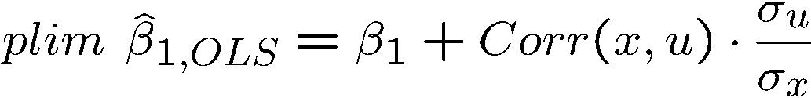
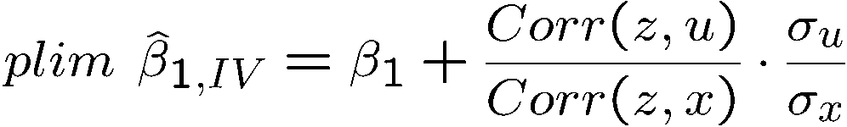
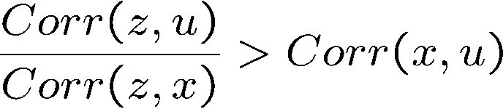
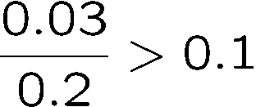
plim = Probability limit
Estimator is consistent if the probability limit is equal to true parameter.
Note 2SLS IV is consistent but not unbiasd
IV health warning
Properties of IV with a poor instrumental variable
IV may be much more inconsistent than OLS if the instrumental variable is not completely exogenous and only weakly related to explanatory var x
There is no problem if the instrumental variable is really exogenous. If not, the asymp-totic bias will be the larger the weaker the correlation with x.
IV worse than OLS if:
e.g.
That’s why we want the first stage F-statistic to be large!

Slide 20
More instrumental variable examples

Slide 21

Additional controls many IV’s example: Family size
$$Y=βFamSize+ε$$
Are large families good or bad?
What do you think?
Many potential confounders. Family size is by and large a choice
Poorer and less educated parents tend to have more kids
The same factors could drive outcomes

Slide 22
Family size and children outcomes
(Study by Angrist, Lavy & Schlosser)
However, there is randomness in family size as well
Two factors that are out of control of controlling parents:
Occurrence of twins
Sex of baby
Ok those might meet criteria 1 from earlier but how about criteria 2?
Twins: families might only have planned for 2 kids, but when they had twins they un-intentionally had 3
Many families have preference for a sex mix (a boy and a girl)
Hence, if they have two kids of the same sex they are more likely to carry on having more kids

Slide 23
Second stage

Slide 24
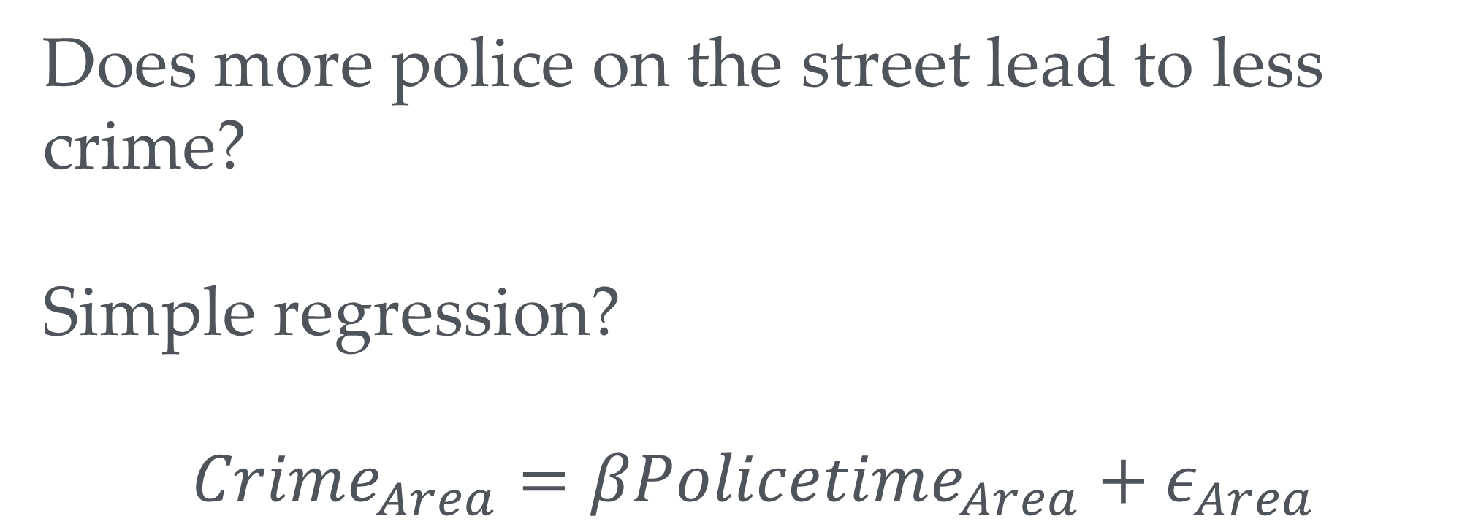
Panic on the streets of London (Study by Draca, Machin and Witt)
→
Does more police on the street lead to less crime?
Simple regression?
$$Crime_{Area}=βPolicetime_{Area}+ε_{Area}$$
Police go where the crime is

Slide 25
Panic on the streets of London (Study by Draca, Machin and Witt)
→
Solution:
Use as instrument
July 7 bombings of 2005 led to increases in police in certain areas (central London, near tube stations) which had nothing to do with crimes such as pick pocketing etc.
Results: 10% more police activity reduces crime by 3 to 4 percent.

Slide 26
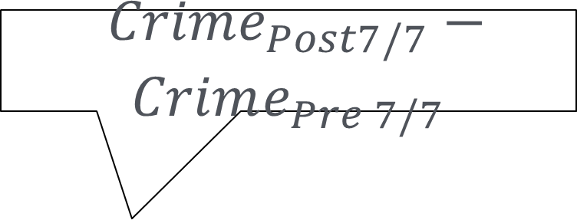
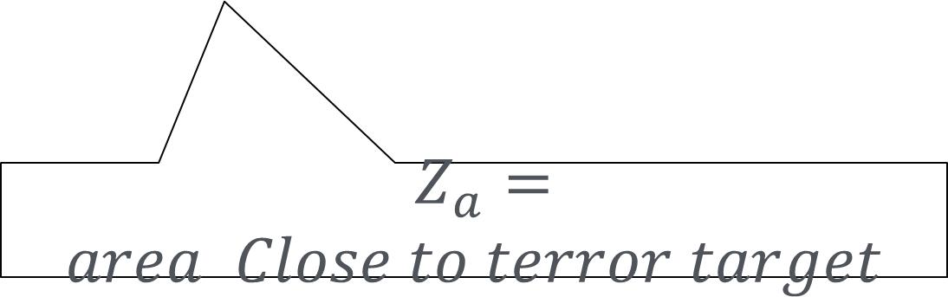
Panic on the streets of London
$Crime_{Post7/7}−Crime_{Pre 7/7}$
$$ΔCrime_{a}=βΔPolice_{a}+ε_{a}$$
$Z_{a}=area Close to terror target$

Slide 27
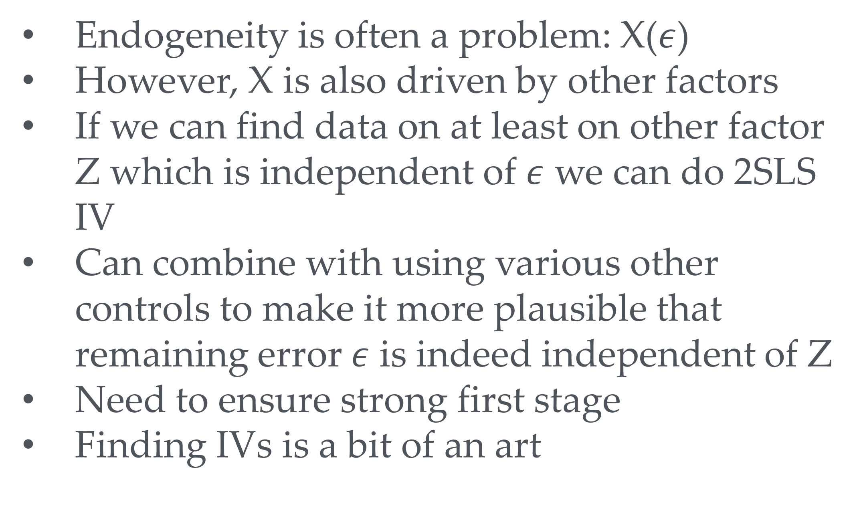
Summary
→
Endogeneity is often a problem: X($ε$)
However, X is also driven by other factors
If we can find data on at least on other factor Z which is independent of $ε$ we can do 2SLS IV
Can combine with using various other controls to make it more plausible that remaining error $ε$ is indeed independent of Z
Need to ensure strong first stage
Finding IVs is a bit of an art

